Slide 1
HTML DOM

Slide 2
When a web page is loaded, the browser creates a Document Object Model of the page.
The HTML DOM model is constructed as a tree of Objects:

Slide 3
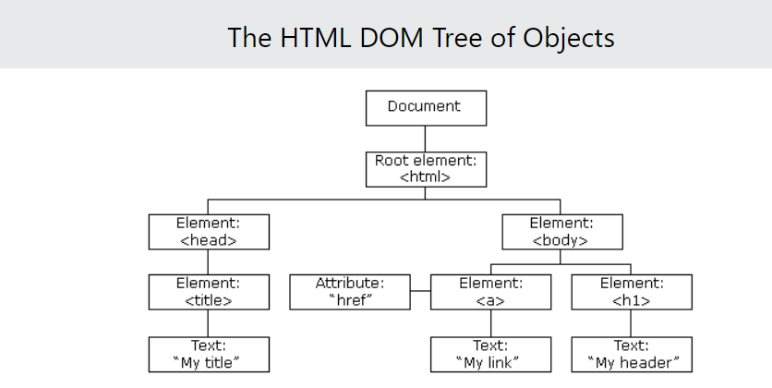

Slide 4
With the object model, JavaScript gets all the power it needs to create dynamic HTML:
JavaScript can change all the HTML elements in the page
JavaScript can change all the HTML attributes in the page
JavaScript can change all the CSS styles in the page
JavaScript can remove existing HTML elements and attributes
JavaScript can add new HTML elements and attributes
JavaScript can react to all existing HTML events in the page
JavaScript can create new HTML events in the page

Slide 5
What is the DOM?
The W3C Document Object Model (DOM) is a platform and language-neutral interface that allows programs and scripts to dynamically access and update the content, structure, and style of a document."

Slide 6
What is the HTML DOM?
The HTML DOM is a standard object model and programming interface for HTML.
It defines:
The HTML elements as objects
The properties of all HTML elements
The methods to access all HTML elements
The events for all HTML elements
In other words: The HTML DOM is a standard for how to get, change, add, or delete HTML elements.

Slide 7
JavaScript - HTML DOM Methods
HTML DOM methods are actions you can perform (on HTML Elements).
HTML DOM properties are values (of HTML Elements) that you can set or change.

Slide 8
The DOM Programming Interface
The innerHTML property can be used to get or change any HTML element, including <html> and <body>.
In the DOM, all HTML elements are defined as objects.
The programming interface is the properties and methods of each object.
A property is a value that you can get or set (like changing the content of an HTML element).
A method is an action you can do (like add or deleting an HTML element).
The innerHTML property can be used to get or change any HTML element, including <html> and <body>

Slide 9
JavaScript HTML DOM Document
The HTML DOM document object is the owner of all other objects in your web page.
The document object represents your web page.
If you want to access any element in an HTML page, you always start with accessing the document object.
Notes:
If you want to access any element in an HTML page, you always start with accessing the document object.

Slide 10
Finding HTML Elements
Method | Description
document.getElementById(id) | Find an element by element id
document.getElementsByTagName(name) | Find elements by tag name
document.getElementsByClassName(name) | Find elements by class name

Slide 11
Finding HTML Elements
Often, with JavaScript, you want to manipulate HTML elements.
To do so, you have to find the elements first. There are several ways to do this:
Finding HTML elements by id(second.html,third.html)
Finding HTML elements by tag name(fourth.html,fifth.html)
Finding HTML elements by classname(sixth.html,seventh.html)
Finding HTML elements by CSS selectors
Finding HTML elements by HTML object collections

Slide 12
JavaScript HTML DOM - Changing HTML
The HTML DOM allows JavaScript to change the content of HTML elements.
The HTML DOM allows JavaScript to change the content of HTML elements.
To change the content of an HTML element, use this syntax:
document.getElementById(id).innerHTML = new HTML
Nine.html
Ten.html
Eleven.html

Slide 13
Dynamic HTML content
Twelve.html
Thirteen.html
JavaScript can create dynamic HTML content:

Slide 14
JavaScript Form Validation
HTML form validation can be done by JavaScript.
If a form field (fname) is empty, this function alerts a message, and returns false, to prevent the form from being submitted:
Fourteen.html

